Slide 1




Solutions to poverty, violence, education, health and other challenges
by Dr. Rodolfo Luthe, Ph. D.

Slide 2



All challenges can be solved
Poverty, violence, education, health and other challenges are world wide and they can be solved. The solution comes from companies with leaders socially responsible.

Slide 3
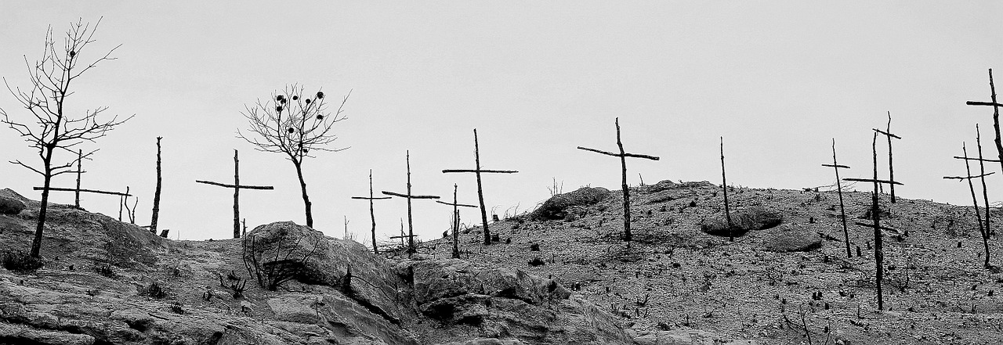
The solution comes from the socially responsible management leader
The solution is with the management leaders having a thought:
I don’t want this in my country.

Slide 4

The XXI Century Enterprise is a new paradigm
These kind of leaders are needed in the project: The XXI Century Enterprise. This new paradigm has been developed by the Wisdom Board Foundation.

Slide 5
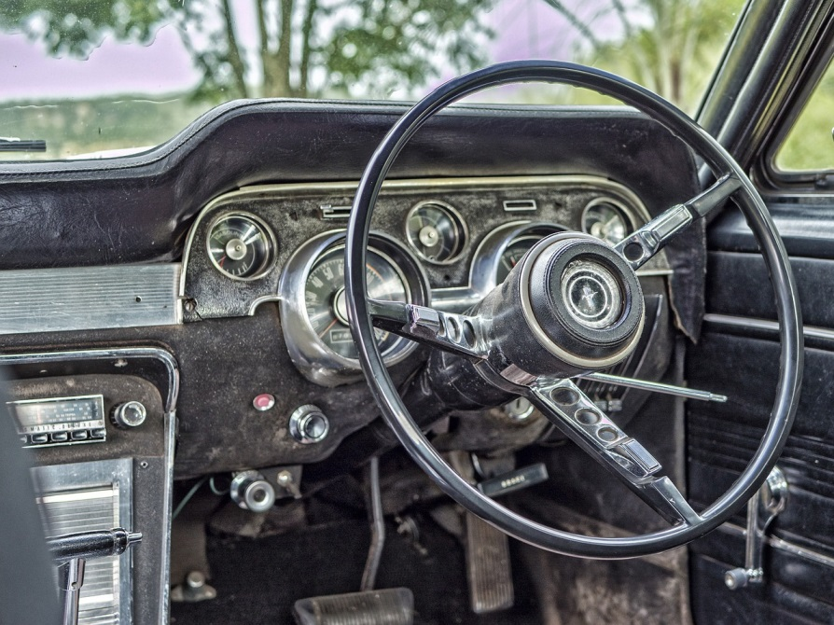
A business leader generates a new playground paradigm
Violence in streets and playgrounds is a sad situation for two children, in USA, because they didn’t have a place to play and got into a car with the engine running, dying intoxicated.

Slide 6
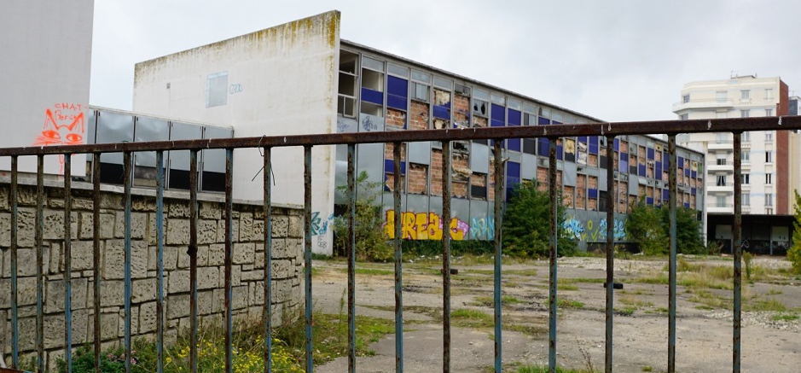
A business leader decides: I don’t want this in my country
A socially responsible business leader, Darell Hammond, decides that he doesn’t want this in his country. He knows by experience that the enterprise has a better solution compared with the government, since there is garbage and there are drug addicts in the playgrounds.

Slide 7
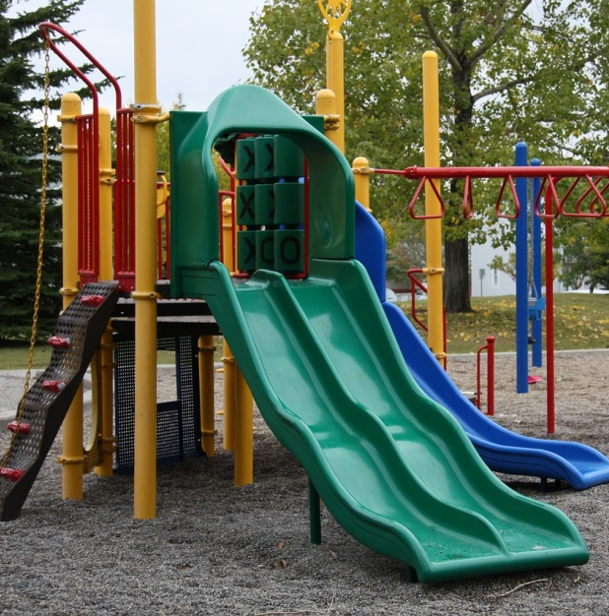
A business leader builds the new playgrounds
As a leader, Darell Hammond has skills to work as a team with other leaders, organizations, government, family and society, in general.
He started a construction and adaptation project building playgrounds for children, lasting 25 years, covering practically all his country.

Slide 8
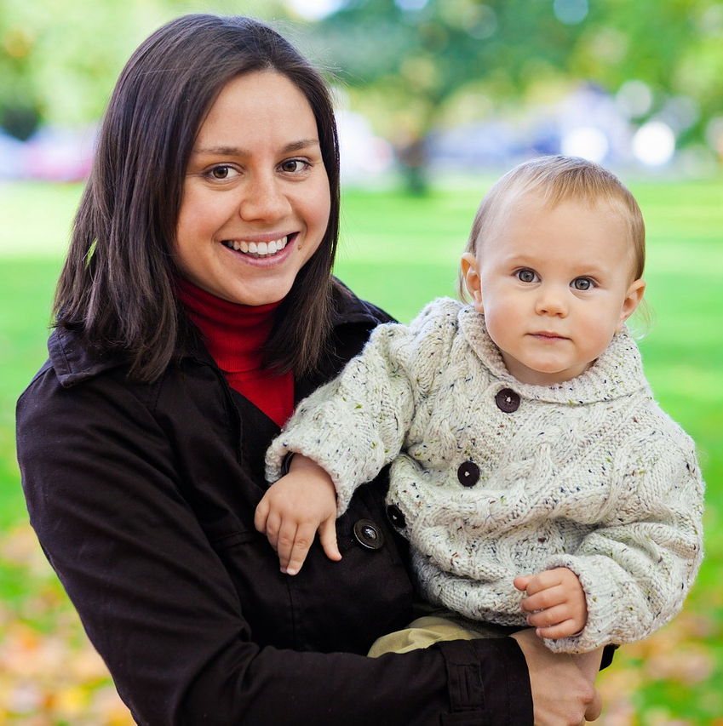
The playground success is due to the moms
His conclusion, after 25 years, is: If moms knew all that they are capable to do, all the problems would be solved.
This solution is available in any part of the world, with socialy responsible leaders, as Darell Hammond, businessman, who said: I don’t want this in my country.

Slide 9
The solutions are the main point in the First International Congress
The Congress main theme is: We want to live in a first world country, with a dignified quality of life for everybody.

Slide 10
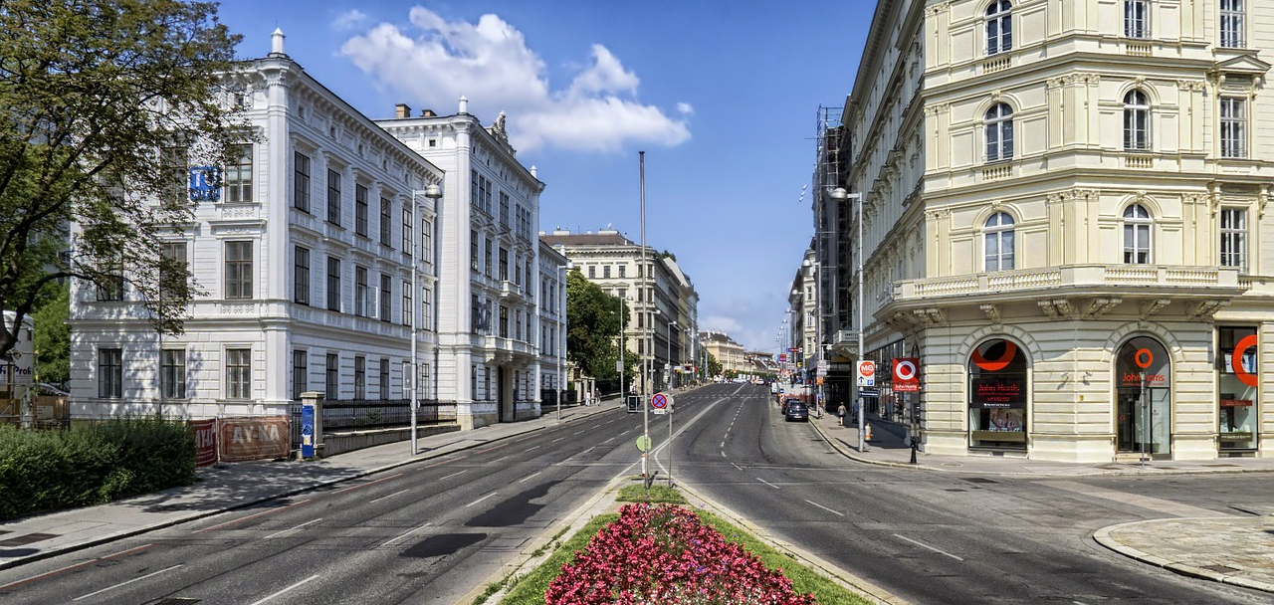
We all want to live in a sustainable country
The human being aspiration is that of participating in a sustainable country, caring for the person, the environment and the profit.

Slide 11

A sustainable country is possible only if the firms are sustainable
The only possible way to live in a first world country is if all the organizations are sustainable, especially the wealth generator enterprises.

