Slide 1


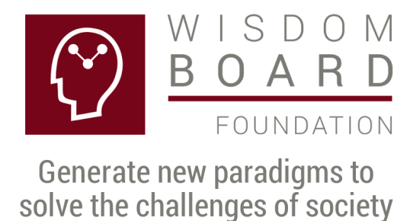
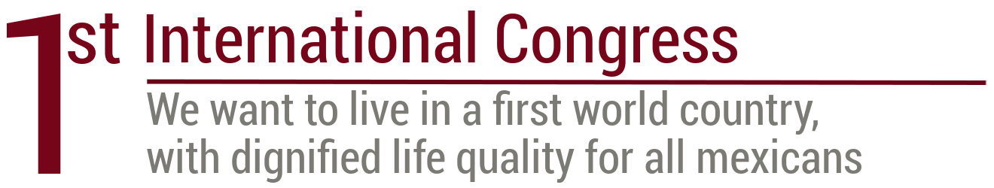
Project to dignify the image and work of the manager and the enterprise
Rodolfo Luthe, Researcher, Ph. D.

Slide 2

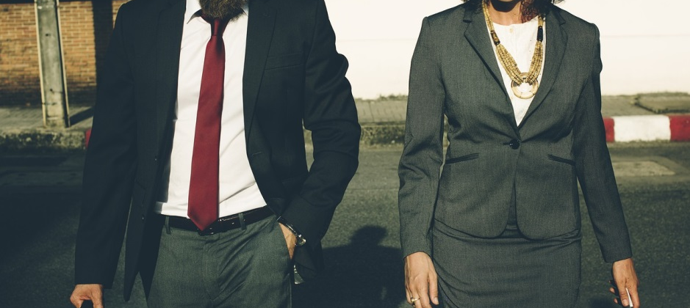

1.- Semblance of a manager
The vision is to promote the manager who cares for Mexico and identifies himself with the society needs and with his community needs in particular.
The mission is to be conscious in our society of the importance in generating value by the manager and the enterprise. Information in www.fundacionjoven.org

Slide 3
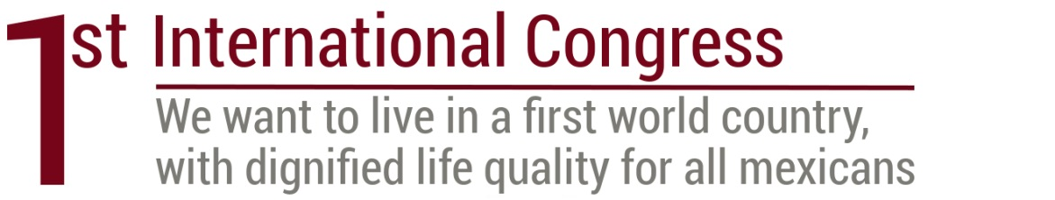
2.- First International Congress:
We want to live in a first world country
This Congress has the characteristic to explain that we are generating and using new paradigms to solve the challenges of our society.

Slide 4

3.- What do we want
We want to live in a first world country with a good quality of life for everybody and we have all the elements to get it.

Slide 5
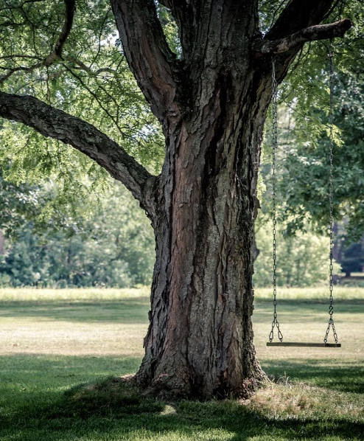
4.- The aspiration of all human beings
It is participating in a sustainable country, caring for the person, the environment and being profitable. Leaders working as a team can get it.

Slide 6

5.- Wisdom Board Foundation
Is the organization in charge of investigating how to deal and solve the challenges and threats in our society.

Slide 7
6.- The challenges
1) Work
2) Health
3) Education
4) Corruption
5) Addictions
6) Children without cancer
7) Brain capacity
development
8) Leader formation process
9) Leaders working as a team
10) Hunger
11) Security
12) Criminal mind
13) Poverty
14) Cancer
15) Violence: Robbery,
Assault, Kidnapping,
16) Sustainable person
17) Sustainable family
18) Sustainable company
19) Sustainable country
20) Sustainable world
21) I want to be a sustainable
and competitive person

Slide 8

7.- Capitalism and communism need a different solution
These ideologies are a collective suicide today and Carlos Llano proposed a solution: “A person is defined by his spirit”.
The reason is because none of these ideologies develops the human being spirit, only the materialism.

Slide 9
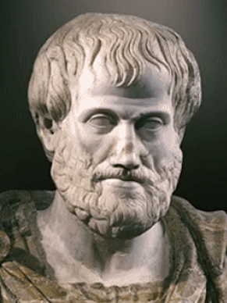
8.- The Aristotle’s Chain
The spirit is the culmination of the Aristotle’s chain taught by Carlos Llano: Mathematics-Physics-Philosophy-Theodicy or Natural theology. In the last science one studies the Perfect Being, that is the universe creator, who is spirit.

Slide 10
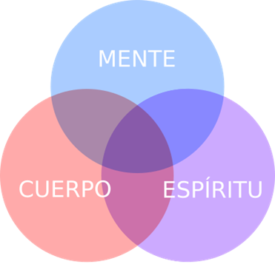
9.- We are spirit, mind and body
These three elements are important and the integral health considers the spirit mind and body of a person.

Slide 11
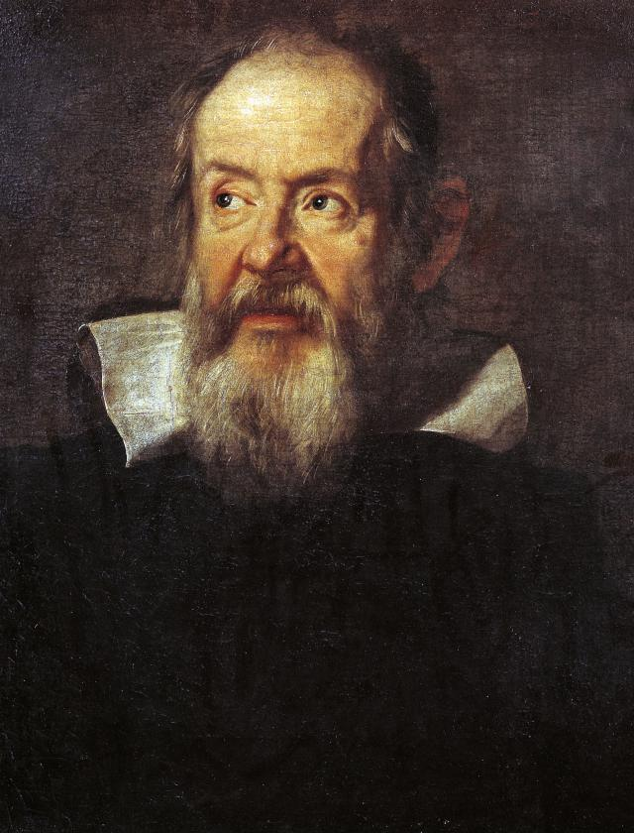
10.- Science changes the world: Galileo
Galileo is the “father” of modern science and he defines two important pillars:
a) Empirical observation and
b) Mathematics.

Slide 12
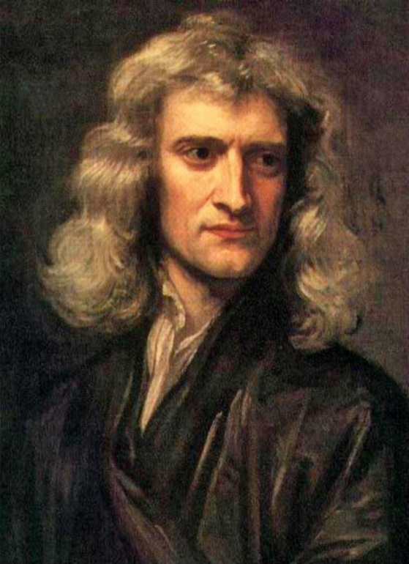
11.- Science changes the world: Newton
Humanity changed with the law of gravity, because we can understand the universe movement.
Also, he defined his third law: For every action, there is an equal and opposite reaction.

Slide 13
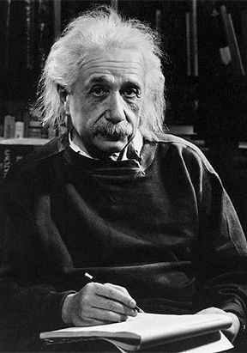
12.- Science changes the world: Einstein
Humanity advances with his energy equation: E = mc², where E is energy, m mass and c light velocity.
His research supports the knowledge at the micro level with the atom and the development of the atom bomb.

Slide 14
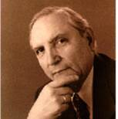
13.- Science changes the world: Luthe
Neural networks are based in the famous Einstein’s equation and the proposed equation is: MI = m*K, K = c²/E, where MI is the Mental Intention of the Golden Rule: Do unto others what you want them doing to you, and m is the number of persons in the Quality of Life Neural Network.

Slide 15
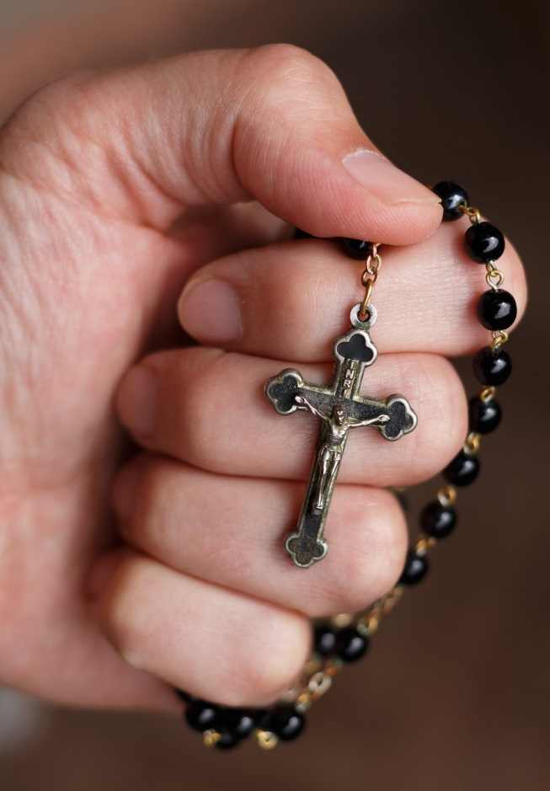
14.- Neural networks include the energy of love
Einstein’s postulate states that the maximum energy in the universe is love and that God is love, and thus we propose the equation: MI^{n} = (m*K)^{n}, where n is the number of believers supporting the Prayer Neural Network. The previous equation is the mathematical expression of the First Commandment.

Slide 16
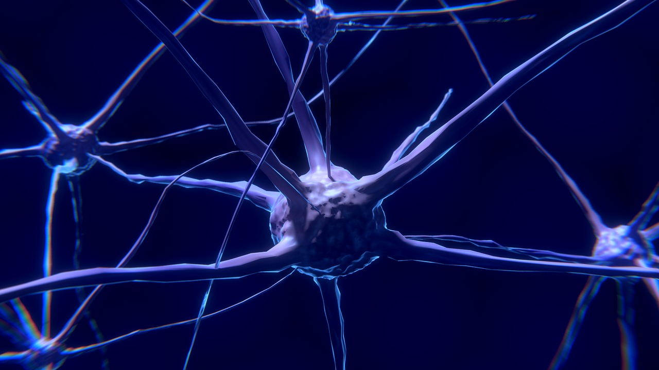
15.- Neural networks postulate
If your neural networks are fine, all is fine.

Slide 17
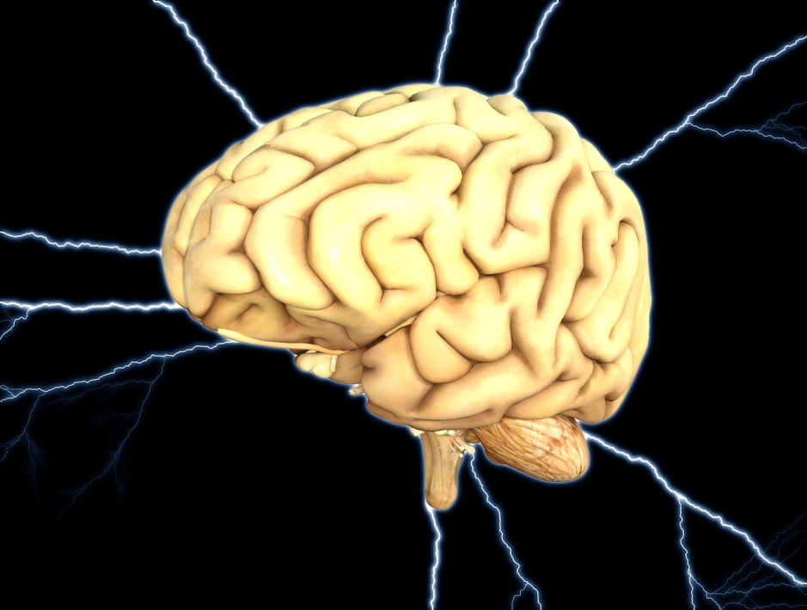
16.- Indisposition cause
The indisposition in spirit, mind and body is because of the neural networks electric disequilibrium.

Slide 18

17.- Mathematics and Physics are important sciences
They are important because we can evaluate the neural networks electric disequilibrium and we can fix it. For this reason some medical doctors forecast that engineers may cure in the future.

Slide 19

18.- The XXI Century Enterprise solves challenges
This company is designed to solve the challenges of our society, besides serving its clients needs, orienting all its efforts to find personal happiness.

Slide 20
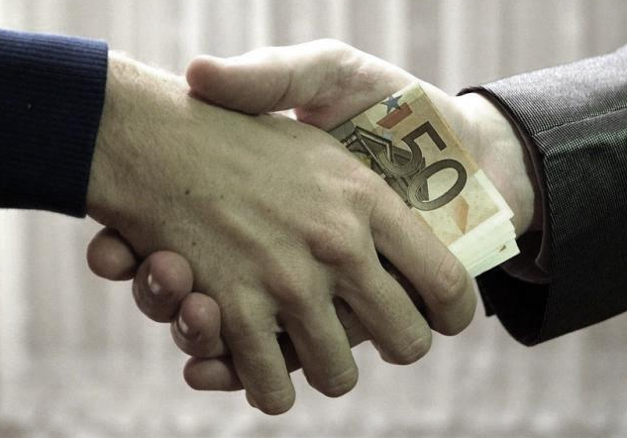
19.- A ZERO corruption organization is required
If we want a first world country with a full quality of life, the necessary condition is that the organizations be ZERO corruption, starting with the family and the enterprise.

Slide 21
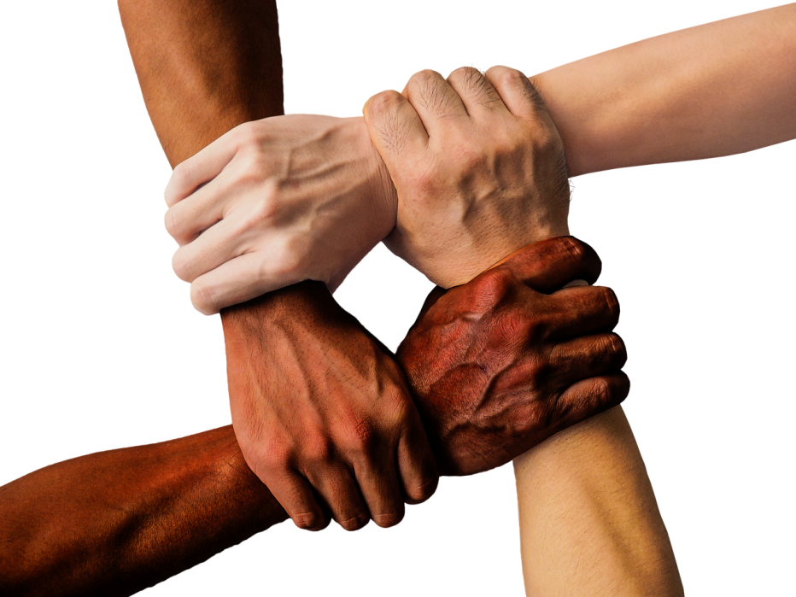
20.- Neural networks are a solution
Collective neural networks are a new paradigm permitting the personal intellectual capacity growth, allowing the reality perception that corruption is the big enemy, being a cancer to our society.

Slide 22
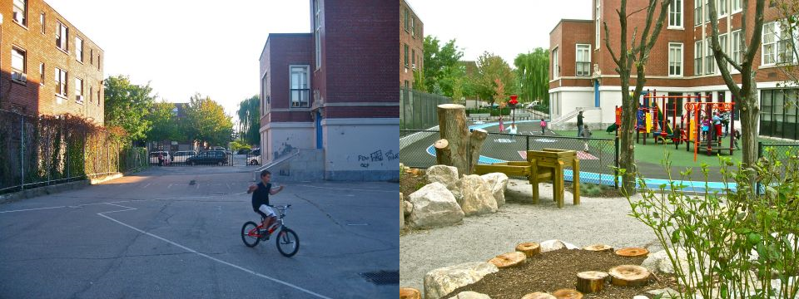
21.- The action is THIS Club:
I don’t want THIS in my country
The inscription is free and we invite you to the best experience, which is building a first world country.

